Slide 1
Classic approaches to Classification Problem
Iftekhar Mahmud Towhid

Slide 2
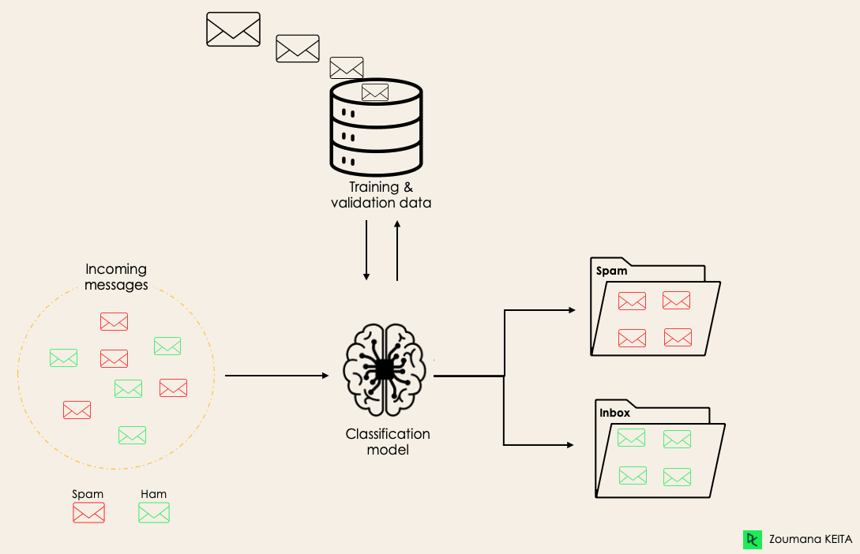
Classification Problem
Classification is a supervised machine learning method where the model tries to predict the correct label of a given input data. In classification, the model is fully trained using the training data, and then it is evaluated on test data before being used to perform prediction on new unseen data.
For instance, an algorithm can learn to predict whether a given email is spam or ham (no spam), as illustrated below.

Slide 3
Lazy Learners Vs. Eager Learners
There are two types of learners in machine learning classification: lazy and eager learners.
Eager learners are machine learning algorithms that first build a model from the training dataset before making any prediction on future datasets. They spend more time during the training process because of their eagerness to have a better generalization during the training from learning the weights, but they require less time to make predictions.
Most machine learning algorithms are eager learners, and below are some examples:
  Logistic Regression.
  Support Vector Machine.
  Decision Trees.
  Artificial Neural Networks.
Lazy learners or instance-based learners, on the other hand, do not create any model immediately from the training data, and this is where the lazy aspect comes from. They just memorize the training data, and each time there is a need to make a prediction, they search for the nearest neighbor from the whole training data, which makes them very slow during prediction. Some examples of this kind are:
  K-Nearest Neighbor.
  Case-based reasoning.

Slide 4
Classification Vs. Regression
Machine Learning There are four main categories of Machine Learning algorithms: supervised, unsupervised, semi-supervised, and reinforcement learning.
Even though classification and regression are both from the category of supervised learning, they are not the same.
The prediction task is a classification when the target variable is discrete. An application is the identification of handwritten characters.
The prediction task is a regression when the target variable is continuous. An example can be the prediction of the salary of a person given their education degree, previous work experience, geographical location, and level of seniority.

Slide 5
Different Types of Classification
There are four main classification tasks in Machine learning:
  Binary classification,
  Multi-class classification,
  Multi-label classification, and
  Imbalanced classifications.

Slide 6
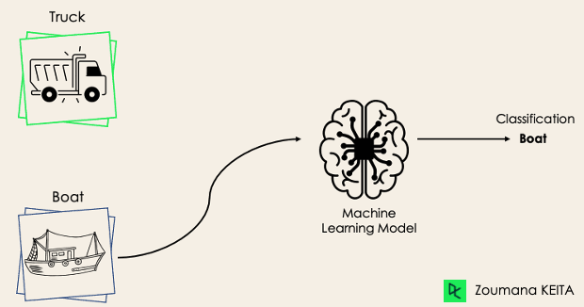
Binary Classification
In a binary classification task, the goal is to classify the input data into two mutually exclusive categories. The training data in such a situation is labeled in a binary format: true and false; positive and negative; O and 1; spam and not spam, etc. depending on the problem being tackled. For instance, we might want to detect whether a given image is a truck or a boat.
Logistic Regression and Support Vector Machines algorithms are natively designed for binary classifications. However, other algorithms such as K-Nearest Neighbors and Decision Trees can also be used for binary classification.

Slide 7
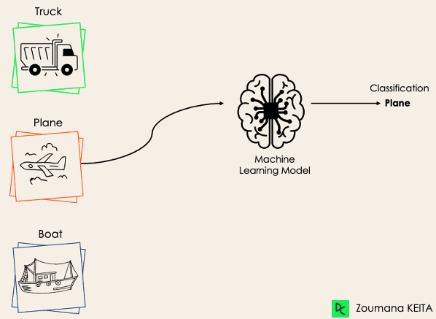
Multi-Class Classification
The multi-class classification, on the other hand, has at least two mutually exclusive class labels, where the goal is to predict to which class a given input example belongs to. In the following case, the model correctly classified the image to be a plane.
Most of the binary classification algorithms can be also used for multi-class classification. These algorithms include but are not limited to:
Random Forest
Naive Bayes
K-Nearest Neighbors
Gradient Boosting
SVM, by applying some trick
Logistic Regression, by applying some trick

Slide 8
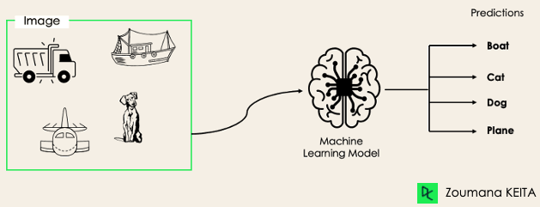
Multi-Label Classification
In multi-label classification tasks, we try to predict 0 or more classes for each input example. In this case, there is no mutual exclusion because the input example can have more than one label.
Such a scenario can be observed in different domains, such as auto-tagging in Natural Language Processing, where a given text can contain multiple topics. Similarly to computer vision, an image can contain multiple objects, as illustrated below: the model predicted that the image contains: a plane, a boat, a truck, and a dog.

Slide 9
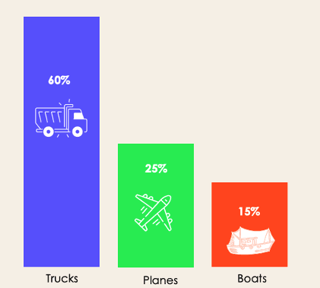
Imbalanced Classification
For the imbalanced classification, the number of examples is unevenly distributed in each class, meaning that we can have more of one class than the others in the training data. Let’s consider the following 3-class classification scenario where the training data contains: 60% of trucks, 25% of planes, and 15% of boats.
The imbalanced classification problem could occur in the following scenario:
  Fraudulent transaction detections in financial industries
  Rare disease diagnosis
  Customer churn analysis
Using conventional predictive models such as Decision Trees, Logistic Regression, etc. could not be effective when dealing with an imbalanced dataset, because they might be biased toward predicting the class with the highest number of observations, and considering those with fewer numbers as noise.

Slide 10
Metrics to Evaluate Machine Learning Classification Algorithms
Now that we have an idea of the different types of classification models, it is crucial to choose the right evaluation metrics for those models. In this section, we will cover the most commonly used metrics:
  Accuracy,
  Precision,
  Recall,
  F1 score, and
  Area under the ROC (Receiver Operating Characteristic) curve and AUC (Area Under the Curve).

Slide 11
Context for understanding metrics
Imagine you are a healthcare startup and want an Al assistant able to predict whether a given patient has a heart disease or not based on its health record. This is a binary classification problem where the model will predict
  1, True or Yes if the patient has heart disease
  0, False or No otherwise

Slide 12
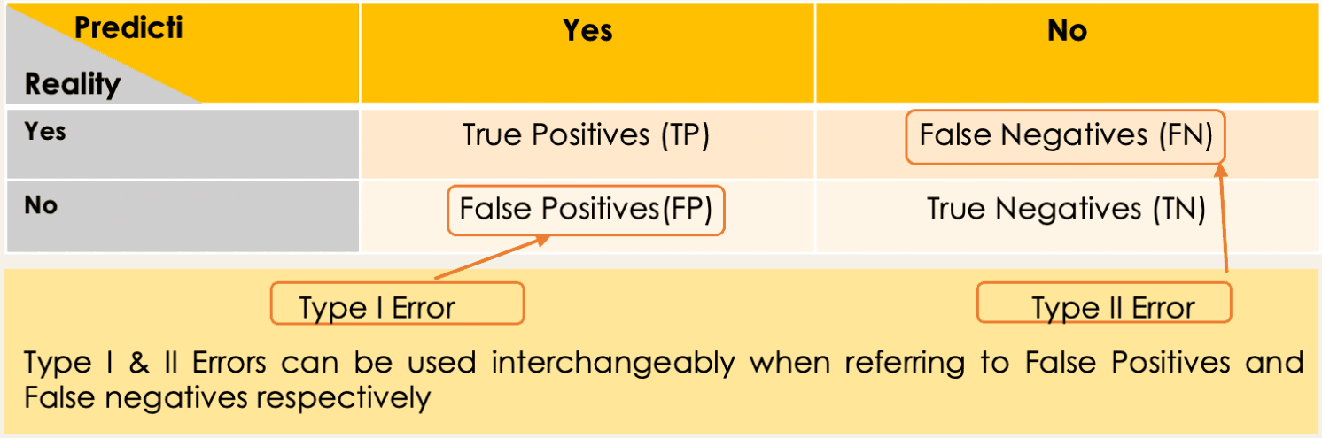
Confusion Matrix
A 2X2 matrix that nicely summarizes the number of correct predictions of the model. It also helps in computing different other performance metrics.

Slide 13
Confusion Matrix
Each cell in the confusion matrix represents an evaluation factor. Let’s understand these factors one by one:
  True Positive(TP) signifies how many positive class samples your model predicted correctly.
  True Negative(TN) signifies how many negative class samples your model predicted correctly.
  False Positive(FP) signifies how many negative class samples your model predicted incorrectly. This factor represents Type-I error in statistical nomenclature. This error positioning in the confusion matrix depends on the choice of the null hypothesis.
  False Negative(FN) signifies how many positive class samples your model predicted incorrectly. This factor represents Type-II error in statistical nomenclature. This error positioning in the confusion matrix also depends on the choice of the null hypothesis.

Slide 14
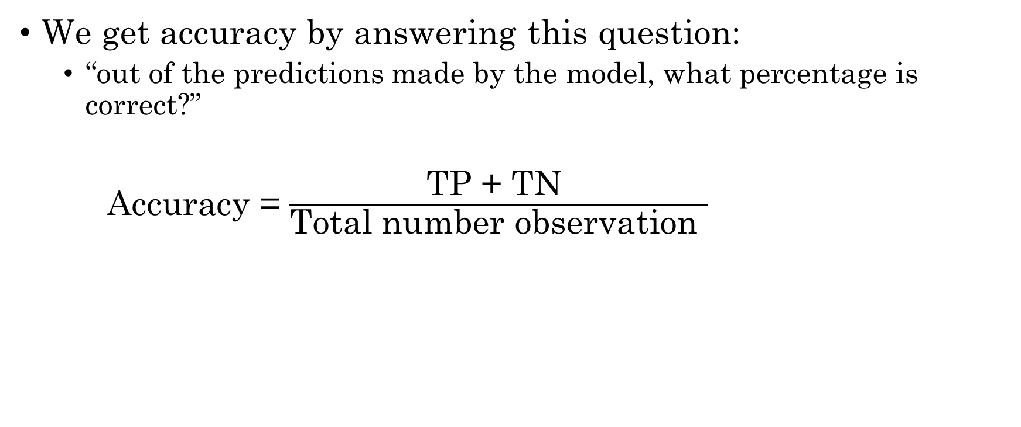
Accuracy
We get accuracy by answering this question:
  “out of the predictions made by the model, what percentage is correct?”
Accuracy = $\frac{\text{TP}\text{ + }\text{TN} }{\text{Total} \text{number} \text{observation} }$

Slide 15
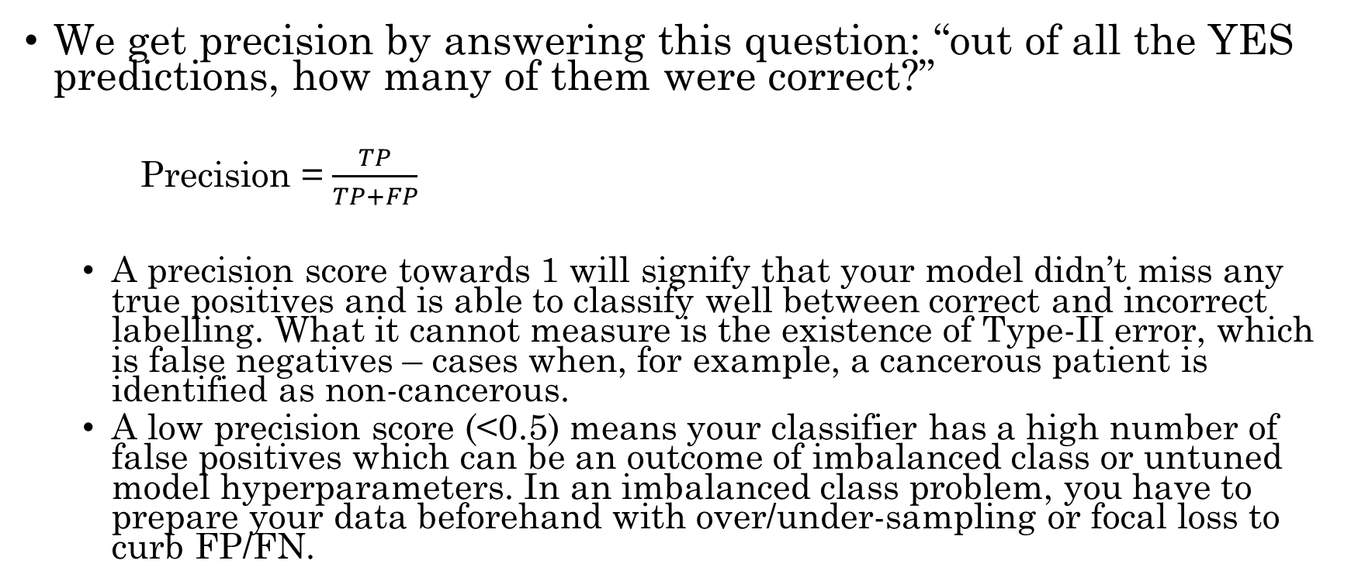
Precision
We get precision by answering this question: “out of all the YES predictions, how many of them were correct?”
  Precision = $\frac{TP}{TP+FP}$
  A precision score towards 1 will signify that your model didn’t miss any true positives and is able to classify well between correct and incorrect labelling. What it cannot measure is the existence of Type-II error, which is false negatives – cases when, for example, a cancerous patient is identified as non-cancerous.
  A low precision score (<0.5) means your classifier has a high number of false positives which can be an outcome of imbalanced class or untuned model hyperparameters. In an imbalanced class problem, you have to prepare your data beforehand with over/under-sampling or focal loss to curb FP/FN.

Slide 16
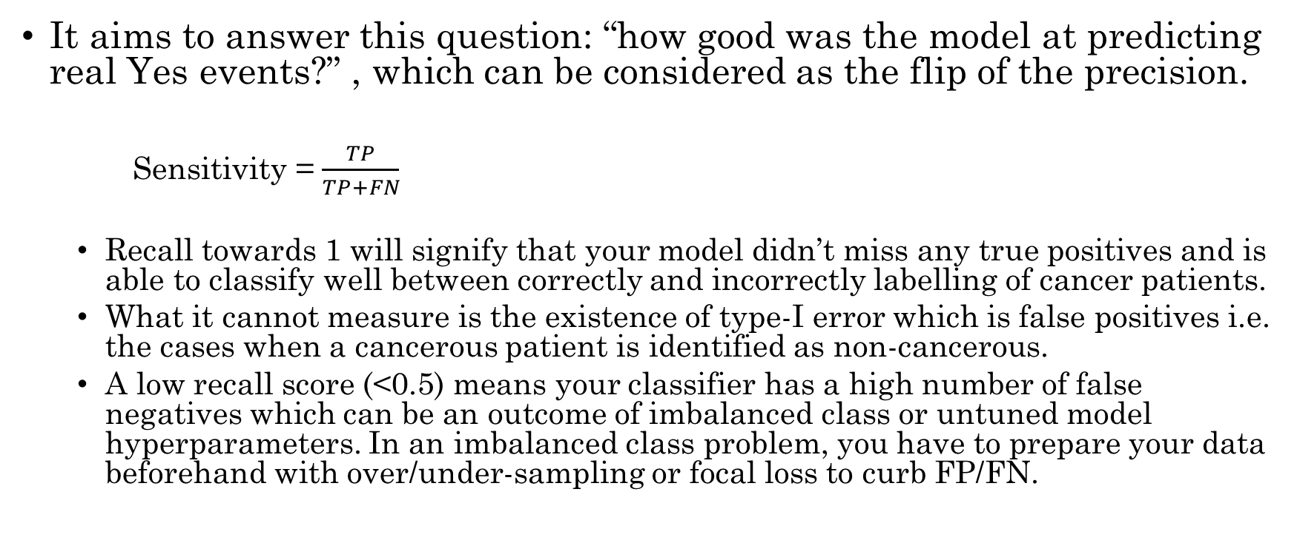
Recall / Sensitivity
It aims to answer this question: “how good was the model at predicting real Yes events?” , which can be considered as the flip of the precision.
  Sensitivity = $\frac{TP}{TP+FN}$
  Recall towards 1 will signify that your model didn’t miss any true positives and is able to classify well between correctly and incorrectly labelling of cancer patients.
  What it cannot measure is the existence of type-I error which is false positives i.e. the cases when a cancerous patient is identified as non-cancerous.
  A low recall score (<0.5) means your classifier has a high number of false negatives which can be an outcome of imbalanced class or untuned model hyperparameters. In an imbalanced class problem, you have to prepare your data beforehand with over/under-sampling or focal loss to curb FP/FN.

Slide 17

Recall / Specificity
It aims to answer this question: “how good was the model at predicting real No events”?
    Specificity = $\frac{TN}{TN+FP}$

Slide 18
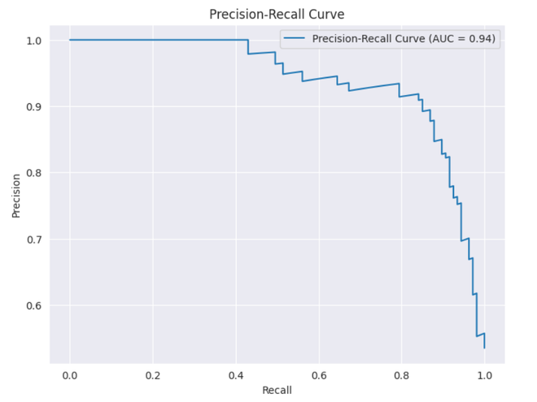
Precision-Recall tradeoff
To improve your model, you can either improve precision or recall – but not both! If you try to reduce cases of cancerous patients being labelled as non-cancerous (FN/type-II), no direct effect will take place on non-cancerous patients being labelled as cancerous (FP/type-I).
This trade-off highly impacts real-world scenarios, so we can deduce that precision and recall alone aren’t very good metrics to rely on and work with. That’s the reason you see many corporate reports and online competitions urge the submission metric to be a combination of precision and recall.

Slide 19
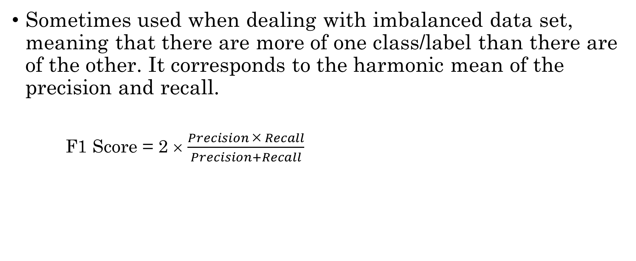
Fl Score
Sometimes used when dealing with imbalanced data set, meaning that there are more of one class/label than there are of the other. It corresponds to the harmonic mean of the precision and recall.
    F1 Score = 2 × $\frac{Precision × Recall}{Precision+Recall}$

Slide 20
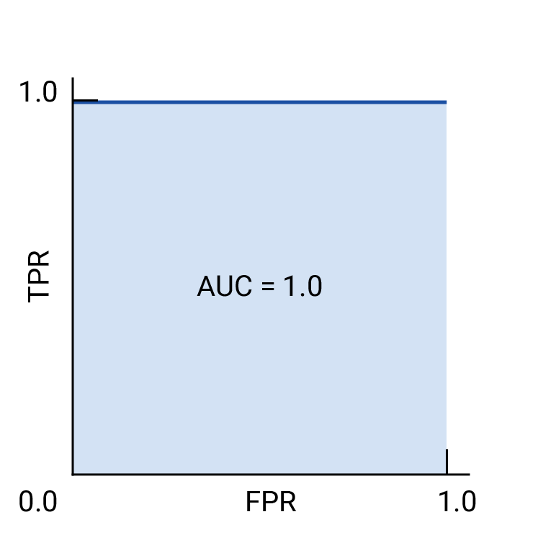

Receiver-operating characteristic curve (ROC)
The ROC curve is a visual representation of model performance across all thresholds.
The ROC curve is drawn by calculating the true positive rate (TPR) and false positive rate (FPR) at every possible threshold (in practice, at selected intervals), then graphing TPR over FPR. A perfect model, which at some threshold has a TPR of 1.0 and a FPR of 0.0, can be represented by either a point at (0, 1) if all other thresholds are ignored, or by the following (right image):
ROC and AUC of a hypothetical perfect model.
$$TPR= \frac{TP}{TP+FN} FPR= \frac{FP}{FP+TN}$$

Slide 21
AUC - ROC Curve
The area under the ROC curve (AUC) represents the probability that the model, if given a randomly chosen positive and negative example, will rank the positive higher than the negative.
AUC— ROC generates probability values instead of binary 0/1 values. It should be used when your data set is roughly balanced.
Using ROC for imbalanced data sets lead to incorrect interpretation.
ROC curves provide good overview of trade-off between the TP rate and FP rate for binary classifier using different probability thresholds.
  A value below 0.5 indicates a poor classifier
  A value of 0.5 means random classifier
  Value over 0.7 corresponds to a good classifier
  0.8 indicates a strong classifier
  We have 1 when the classifier perfectly predicts everything.

Slide 22
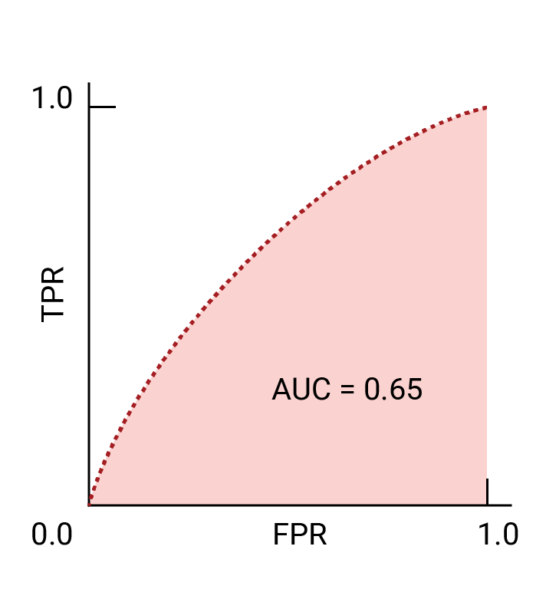
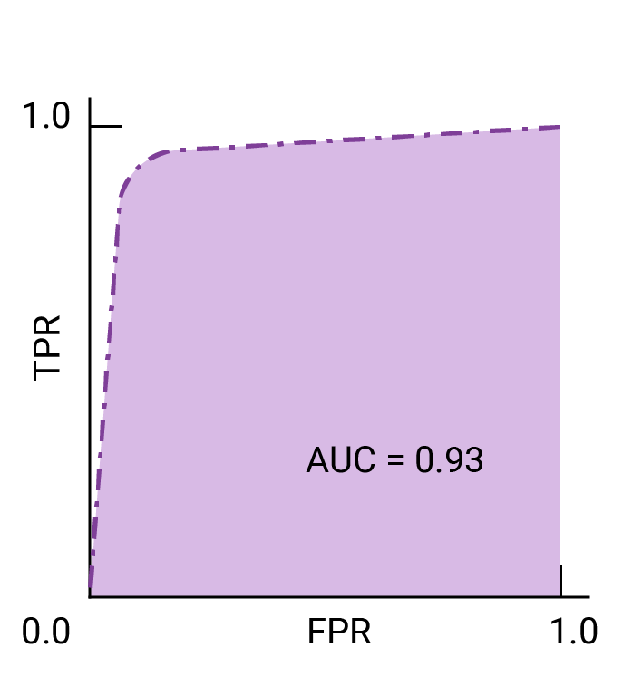
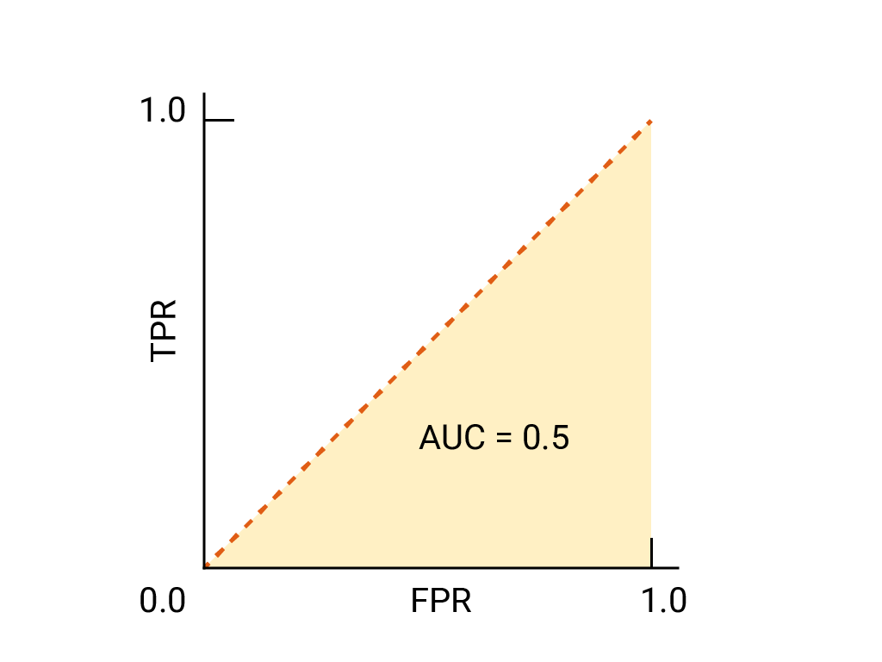
AUC - ROC Curve
ROC and AUC of completely random guesses.
ROC and AUC of two hypothetical models. The curve on the right, with a greater AUC, represents the better of the two models.

Slide 23
Strategies to choose the right metric
Choose accuracy
  The cost of FP and FN are roughly equal.
  The benefit of TP and TN are roughly equal.
Choose Precision
  The cost of FP is much higher than a FN.
  The benefit of a TP is much higher than a TN.
Choose recall
  The cost of FN is much higher than a FP.
  The cost of a TN is much higher than a TP.
ROC AUC & Precision — Recall curves
  Use ROC when the dealing with balanced data sets.
  Use precision-recall for imbalanced data sets.

Slide 24
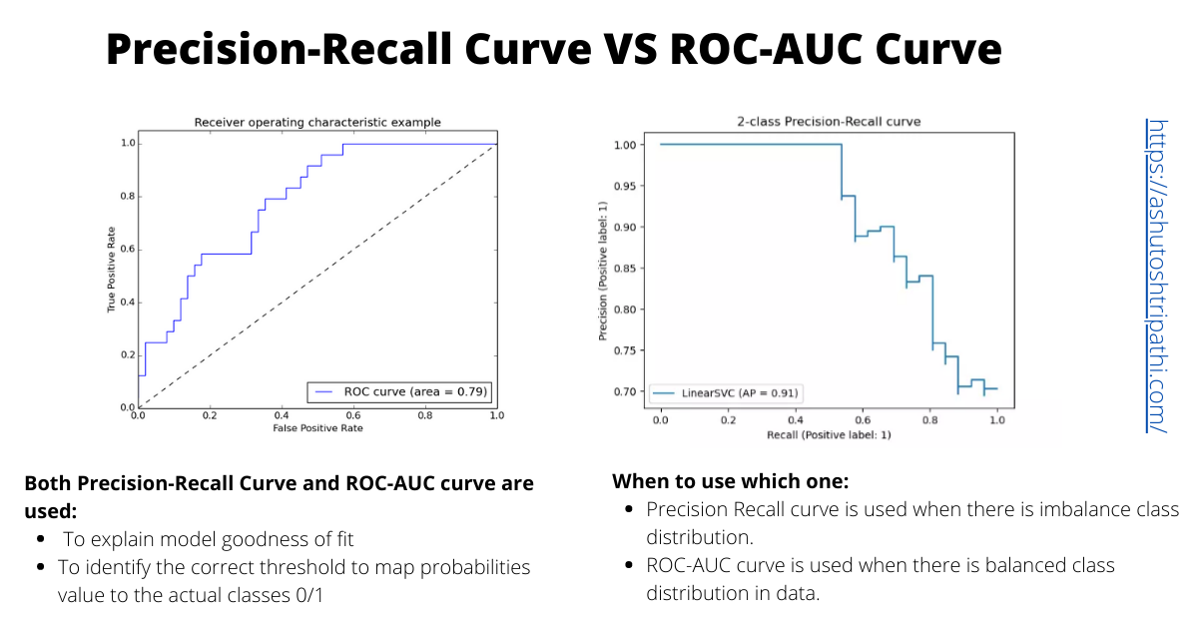
ROC AUC & Precision — Recall curves

Slide 25
Classifiers we will cover
In the next lectures we will cover Naïve Bayes classifier and Decision Tree classifier.

Slide 26
Thanks

